Slide 1

DataCo Supply Chain Data Analysis

Slide 2
Introduction
This is our summarised analysis of the DataCo Global Supply Chain dataset. We will explain the dashboards that we have made in order to answer our business questions and objectives of this project.
With our analysis of this data, it will become increasingly simpler to understand what the KPI’s (Key Performance Indicators) of the company are and how they are faring. This project is aimed at simplifying the work of the entire supply chain management department, help extract valuable insights for the top management to act upon and at the same time understand how the supply chain of a particular company works.

Slide 3
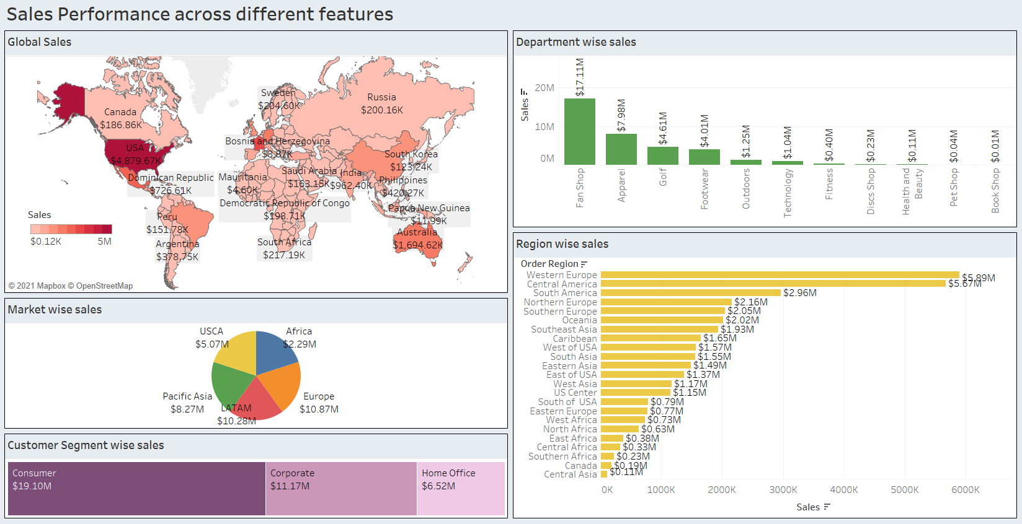

Slide 4
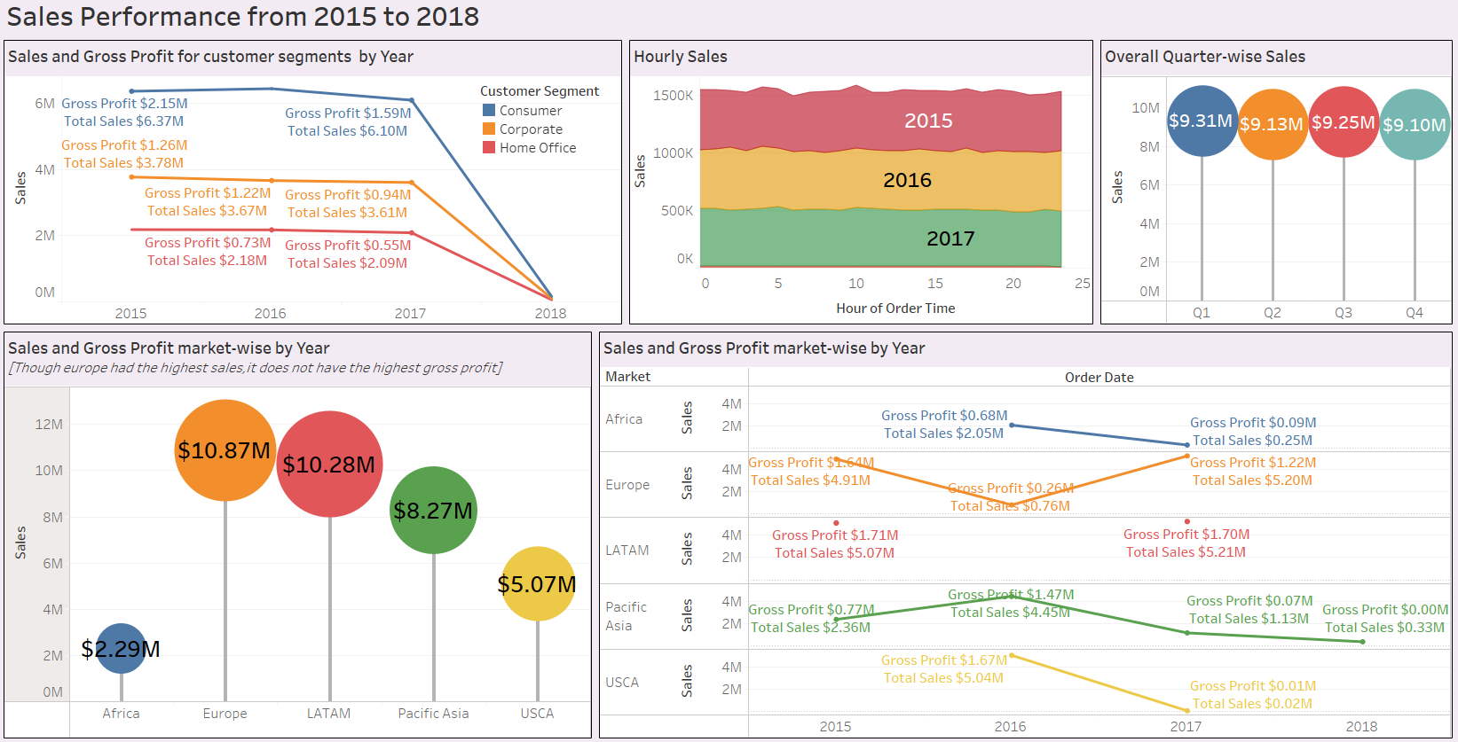

Slide 5
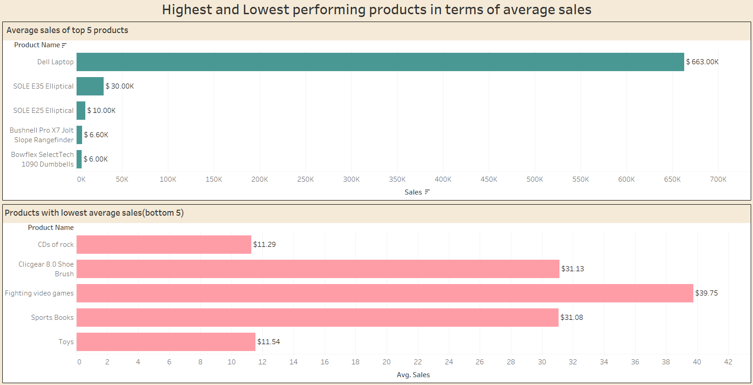

Slide 6
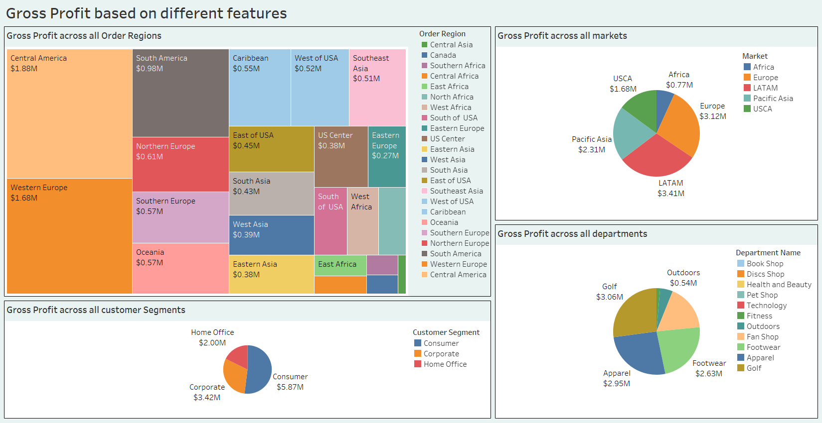

Slide 7
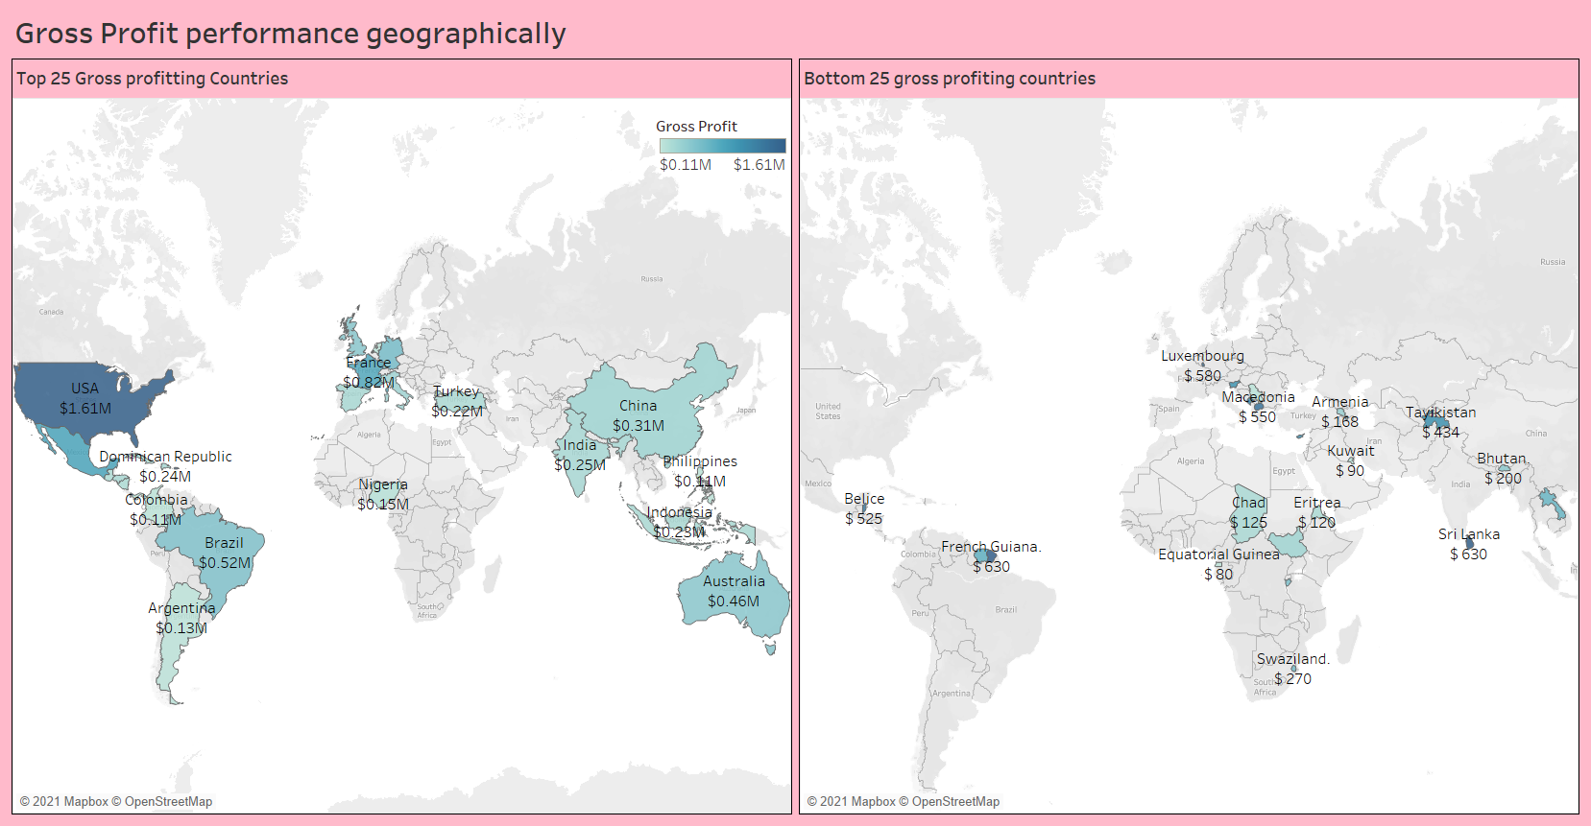

Slide 8
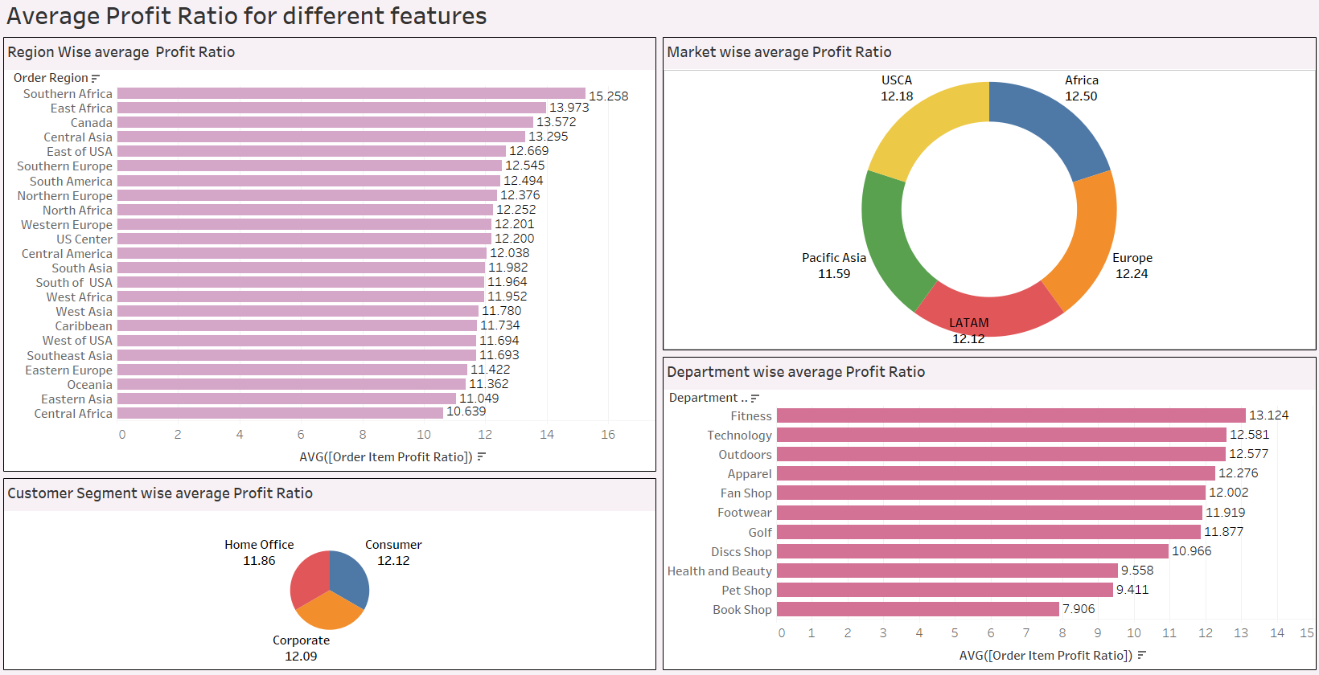

Slide 9
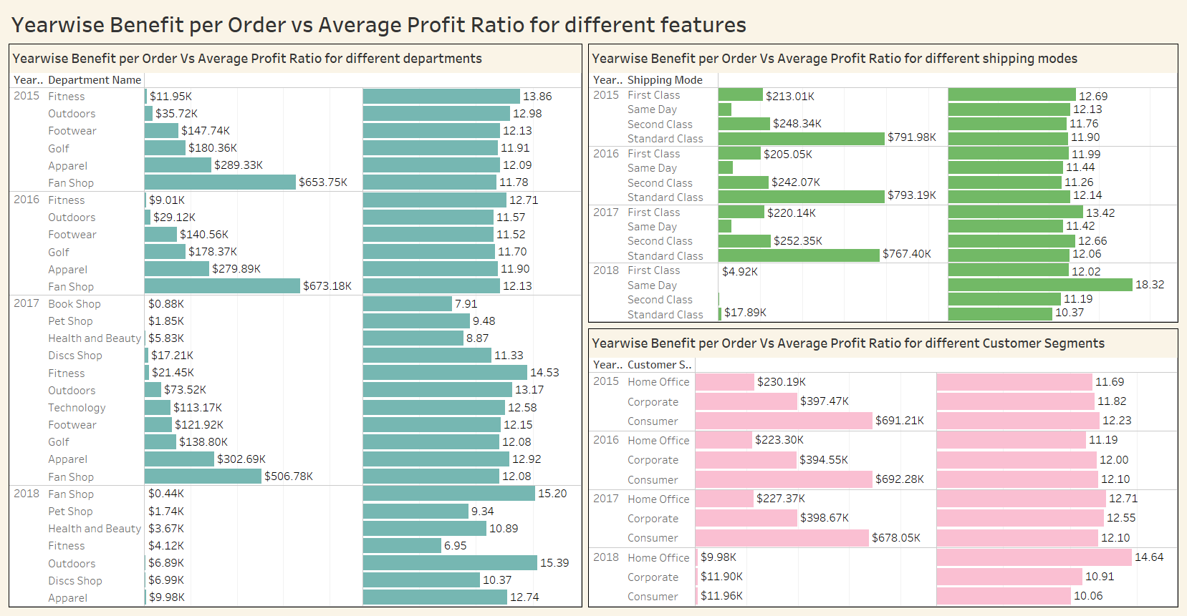

Slide 10
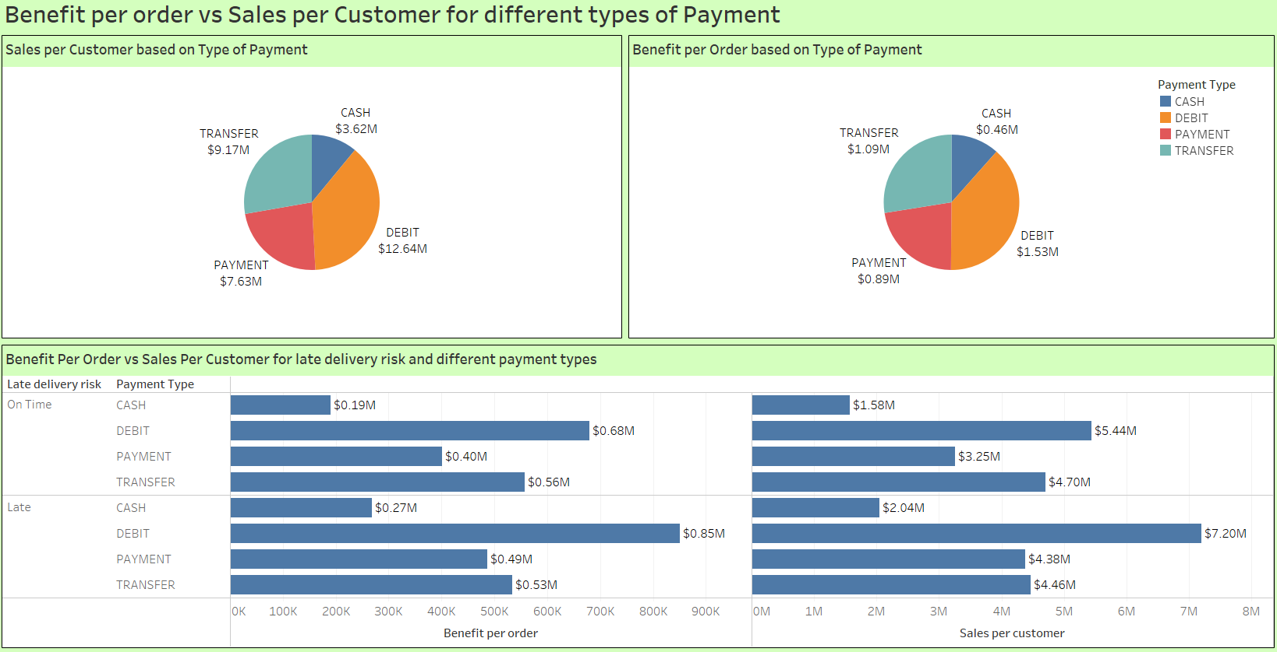

Slide 11
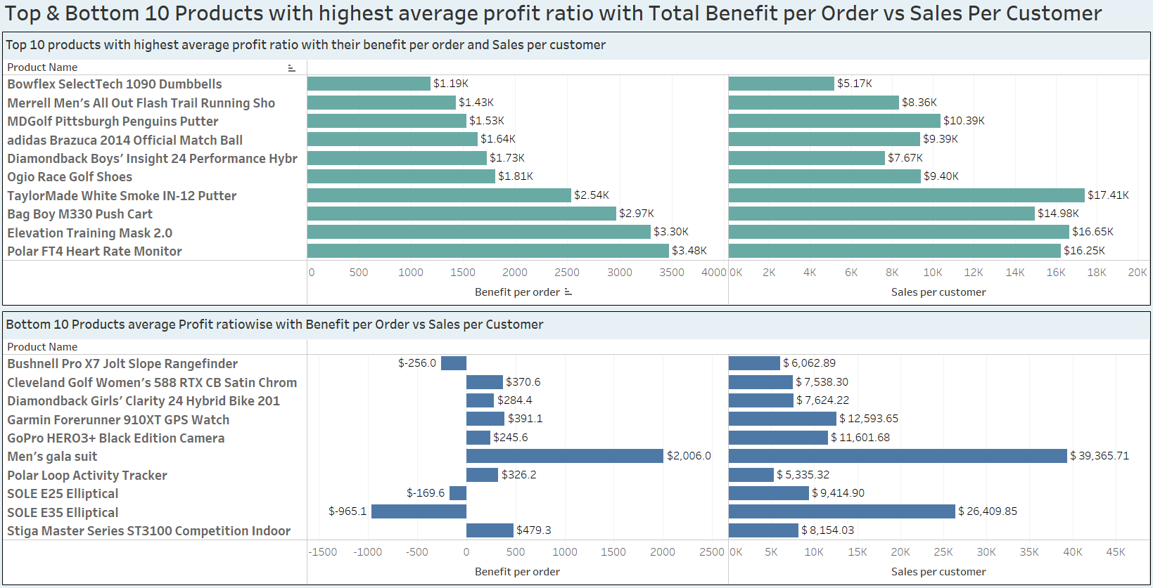

Slide 12
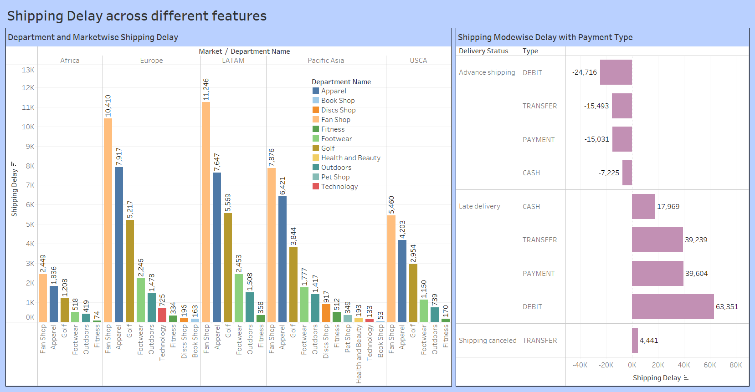

Slide 13
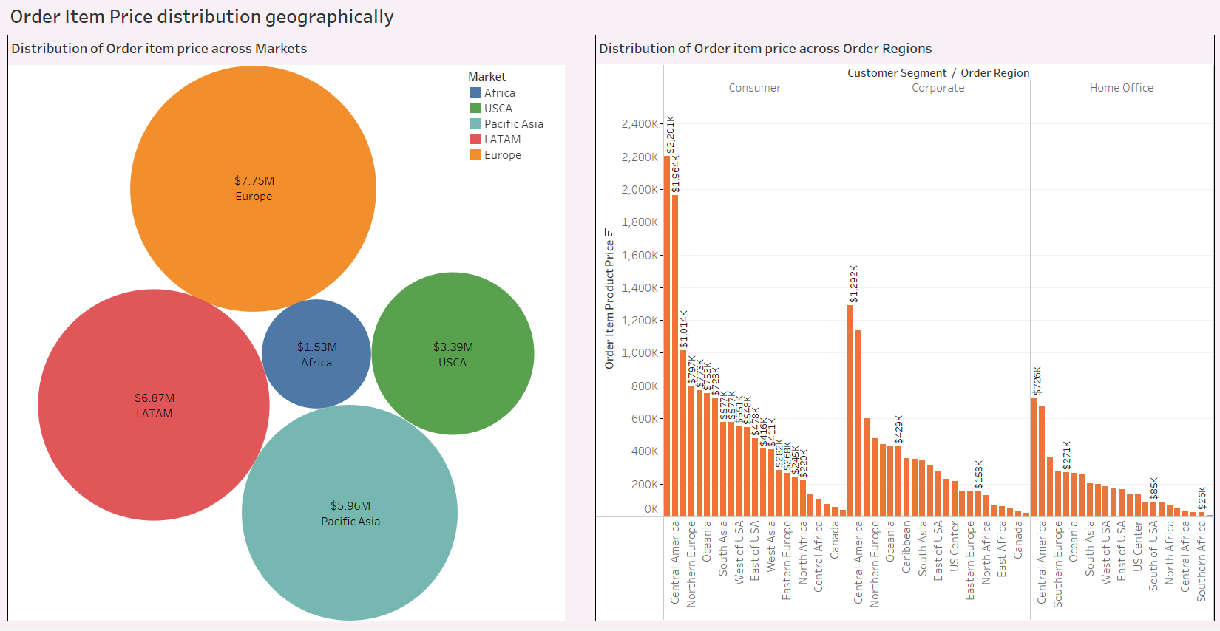

Slide 14
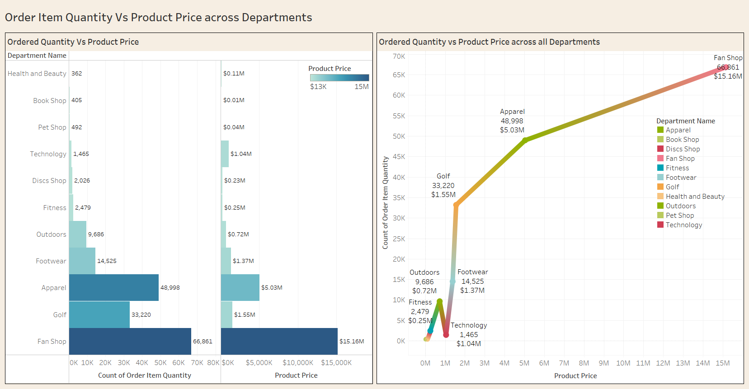

Slide 15
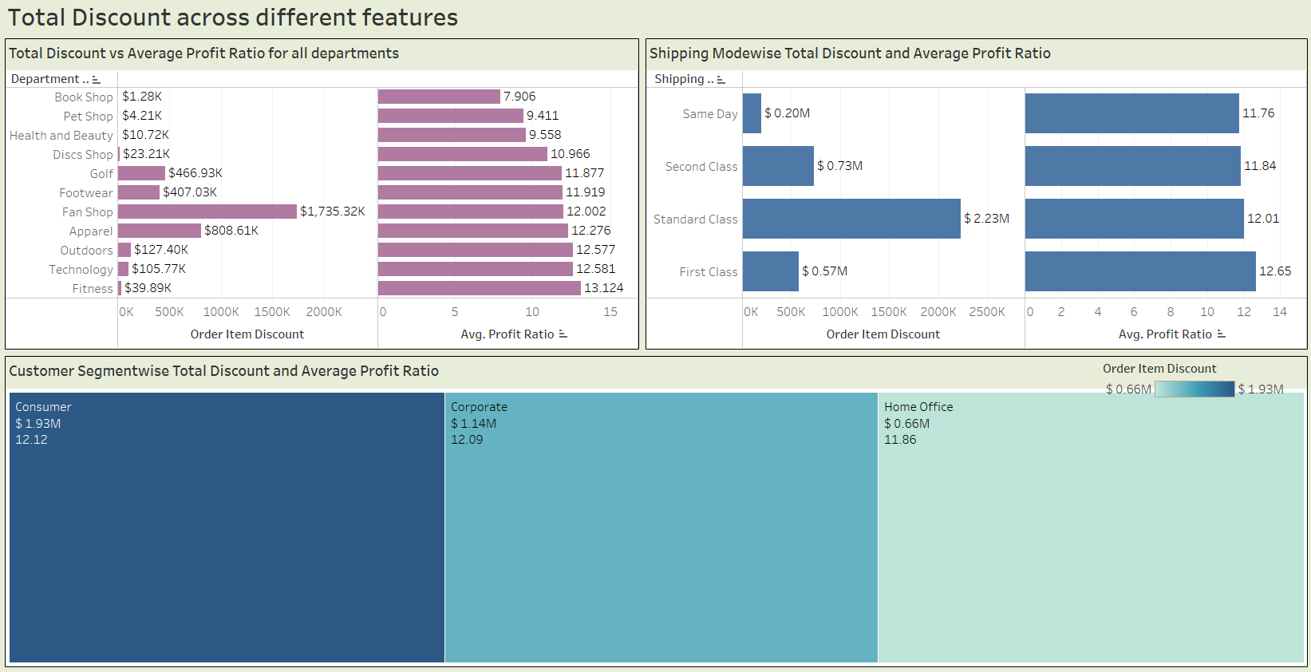

Slide 16
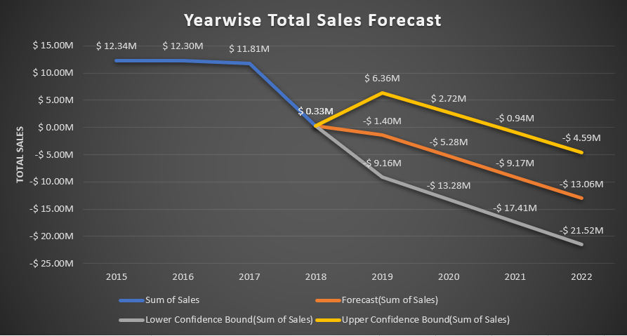
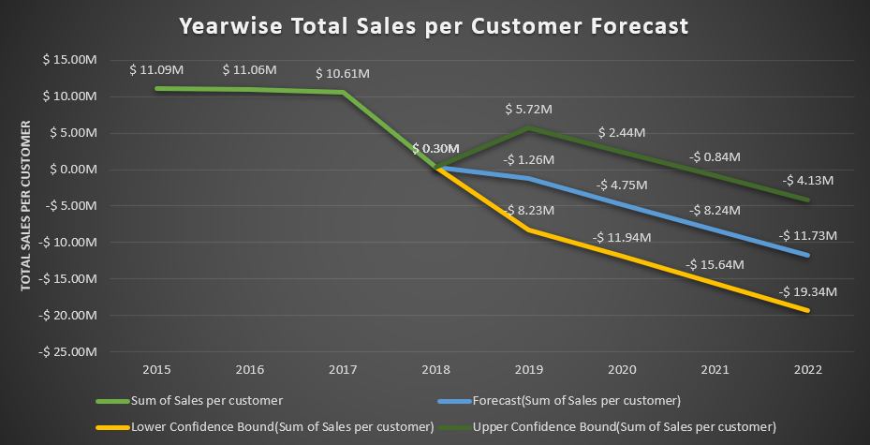
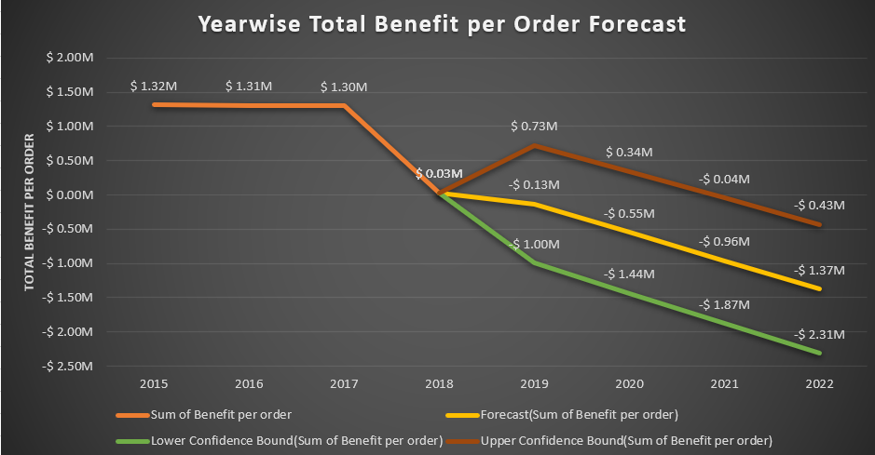
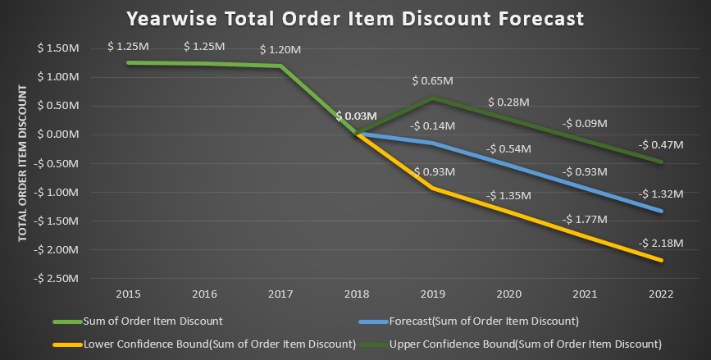
Year wise Forecast

Slide 17
Final Comments and Suggestions
1) The top 10 products with the highest average profit ratio are not even in the list of the top 10 products with highest benefit per order and highest sales per customer. This means that these products could be advertised differently or the approach for their entry into the market could be changed in order to extract the highest benefits from these products.
2) The standard class shipping mode has the highest total benefit per order and sales per customer as compared to same day or first-class shipping mode. While this could also be based on the customer’s personal choices, we think that this is an area which needs to be improved in order to maintain the significance of same day and first-class shipping modes.
3) The late delivered orders have higher total sales and higher total gross profit as compared to the orders that are on time, this needs to be improved as this could prove to be very harmful to the growth of the company in the long run.
4) The standard class shipping mode has no total shipping delay in fact they are delivered before the scheduled delivery date as their total shipping delay is negative while the shipping modes first class and same day have considerable delays. Again, this needs to be corrected as quickly as possible.

Slide 18
5) Africa is the market with the highest average profit ratio while its total sales are the lowest. This is another area where the company could improve and thereby drastically improve their benefits.
6) Fitness department is the most profitable in terms of average profit ratio while its total discount and total sales are the lowest. This is the department which needs to change its strategy and work towards using this potential golden opportunity to reap maximum benefits from it.
7) Shipping mode standard class has the highest provision of total discount even though it does not have the highest average profit ratio amongst all shipping modes. This needs to be corrected.
8) In 2018, the performance was the worst in the four years from 2015 to 2018. This is a highly drastic fall and concerning matter which should have been rectified instantly.

Slide 19
THANK YOU

